Slide 1
19CSE305: MACHINE LEARNING

Slide 2
Support Vector Machines(SVM)
Reference:
Machine Learning-Saikat Dutt, Coursera-Andrew ng, Statquest

Slide 3
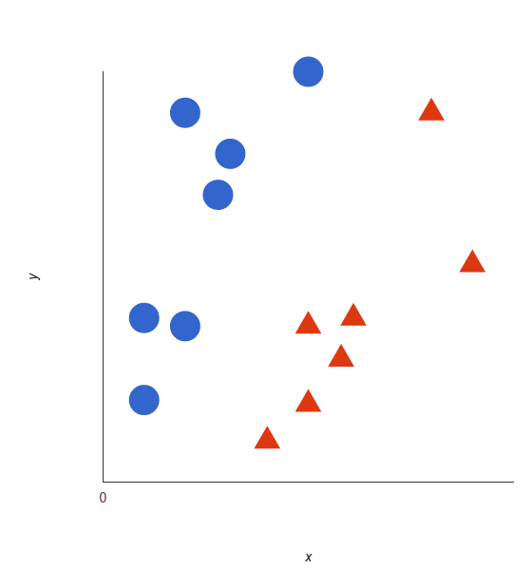
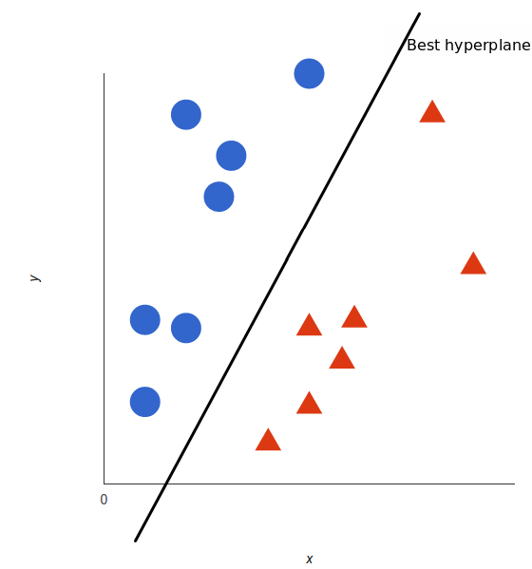
Support Vector Machine (SVM)
Support Vector Machine (SVM) is a supervised machine learning algorithm
Classification , Regression
In the SVM algorithm, we plot each data item as a point in n-dimensional space.
n- Number of features
Classification: by finding the hyper-plane (decision boundary) that differentiates the two classes very well.

Slide 4
Support Vector Machine (SVM)
A hyper plane is a generalization of a plane
In 2D it is a line
In 3D it is a plane
In larger dimension-hyper plane

Slide 5
Support Vector Machine (SVM)
Linearly separable data can be separated by the equation of a line
Y=WX+b
Where Y represents class labels +,-
denotes +1
denotes -1

Slide 6
Support Vector Machine (SVM)
In general for any hyper plane:
W, b -------- Parameters
X -------- Features
Y --------- Class Labels { +ve,-ve}

Slide 7
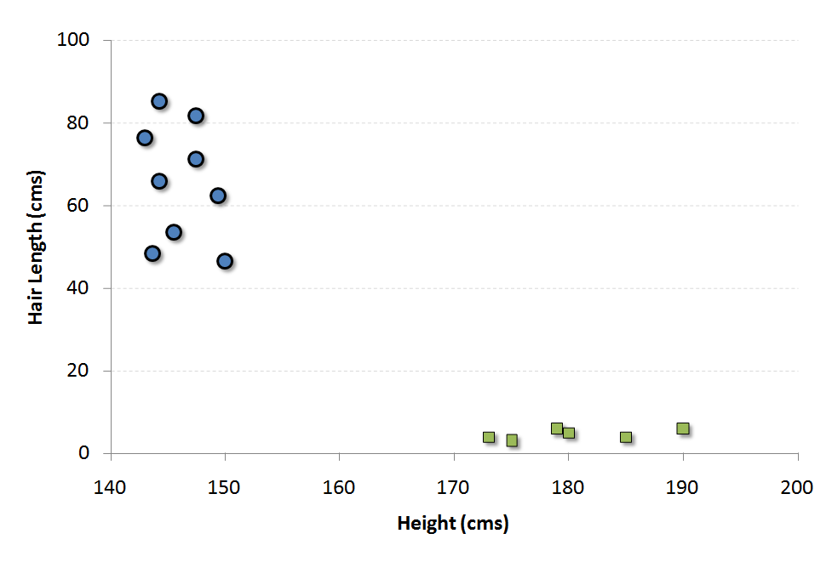
Support Vector Machine (SVM)
Data point lies on the decision boundary.
We can’t say whether the class is +ve or -ve

Slide 8
Support Vector Machine (SVM)
-ve
+ve
Equation for the linear separator lies towards +ve class

Slide 9
Support Vector Machine (SVM)
-ve
M
+ve
Equation for the linear separator lies towards +ve class

Slide 10
Support Vector Machine (SVM)
X1 is the point on L1 and x2 is the point on L2
Divide both sides with
Unit vector in the direction of W

Slide 11
Support Vector Machine (SVM)
We have to maximize the margin
Such that classify all data points correctly
For +ve data point:
For -ve data point:

Slide 12
Support Vector Machine (SVM)
Optimization Problem
Such that
OR
The square term is added to make as a quadratic programming problem which is easy to solve.
Since represents the magnitude
of the vector, squaring will not have
much effect(It magnifies but wont
change the order)

Slide 13
THANK YOU

